Slide 1

PREDICTING SURVIVAL TIMES USING AUTOENCODER AND AFT MODEL
G. M. Nazmus salehin

Slide 2
Objective and Challenges
Collect gene expression data and clinical data from The cancer genome atlas portal.
Use these data to predict overall survival times of glioblastoma patients.
Challenges:
Gene expression data has very high dimension (4570 dimensional, 595 samples). Can we reduce features so that they can preserve the most important gene information ?
Selection of features that are the important predictor of overall survival as well as discarding insignificant features
Select a prediction model and an evaluation metric.
How can we improve accuracy of the predictions ?

Slide 3
Overview
Problem Statement
Data collection
Application of Autoencoder in feature reduction
Exploratory Data Analysis
Choose prediction model and evaluation metric
Final model creation
Results
Further improvements

Slide 4
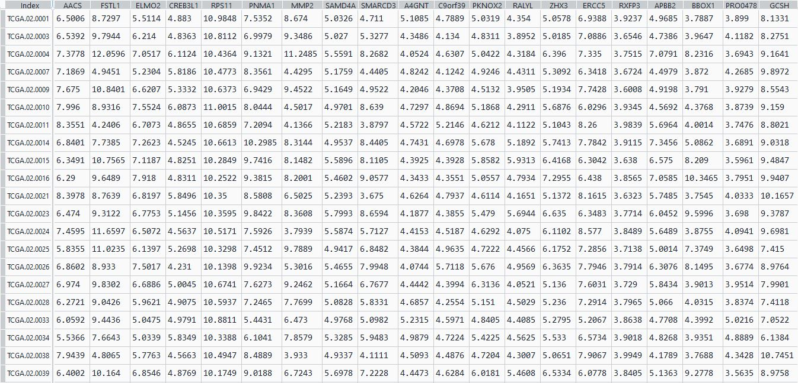
Dataset description

Slide 5
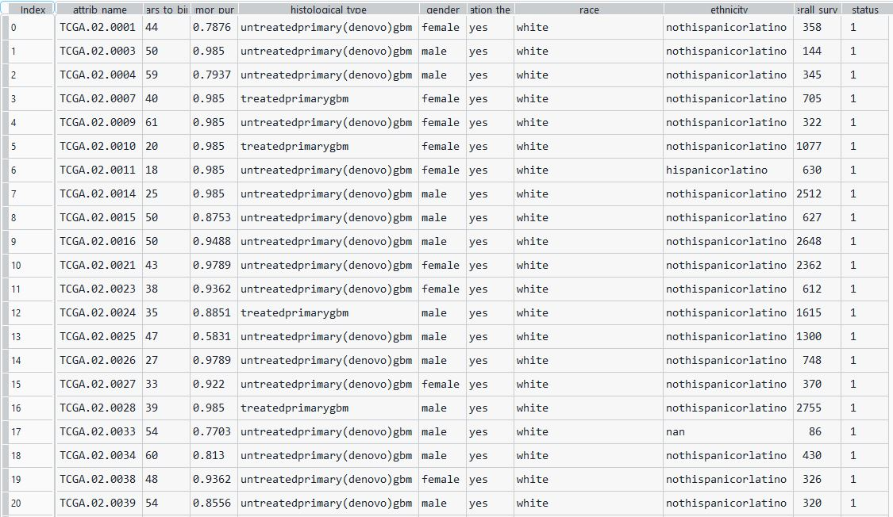
Dataset description (clinical features) )

Slide 6
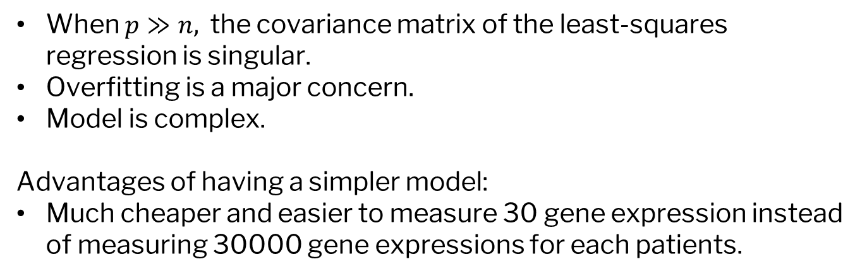
Problems of high dimensional data in survival prediction
When $p≫n,$ the covariance matrix of the least-squares regression is singular.
Overfitting is a major concern.
Model is complex.
Advantages of having a simpler model:
Much cheaper and easier to measure 30 gene expression instead of measuring 30000 gene expressions for each patients.

Slide 7
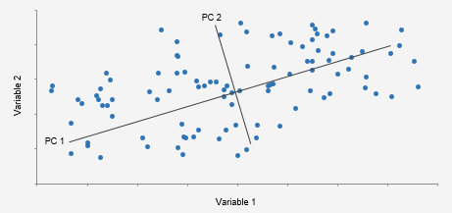
Existing dimension Reduction Techniques
PCA: Use eigenvectors of the covariance matrix of the data and sort the eigenvectors according to their corresponding eigenvalue.

Slide 8
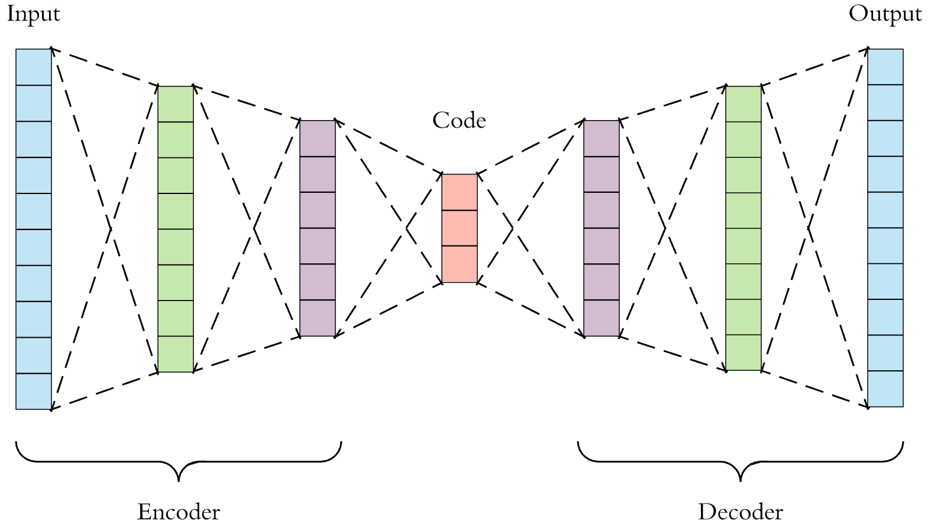
Autoencoder for dimensionality reduction
Autoencoder has following parts:
Encoder: Encodes the input to a reduced dimension
Decoder: Reconstructs the hidden dimension to the original input dimension
Loss Function: Measures how close the reconstruction is compared to the original input. Usually, we use MSE for loss function:

Slide 9
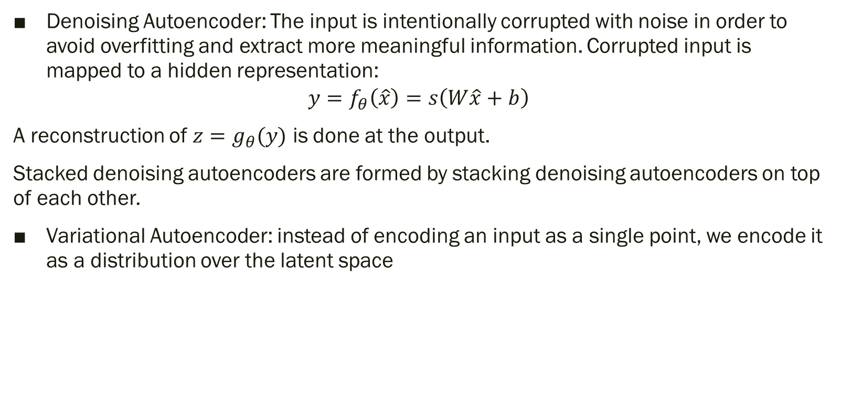
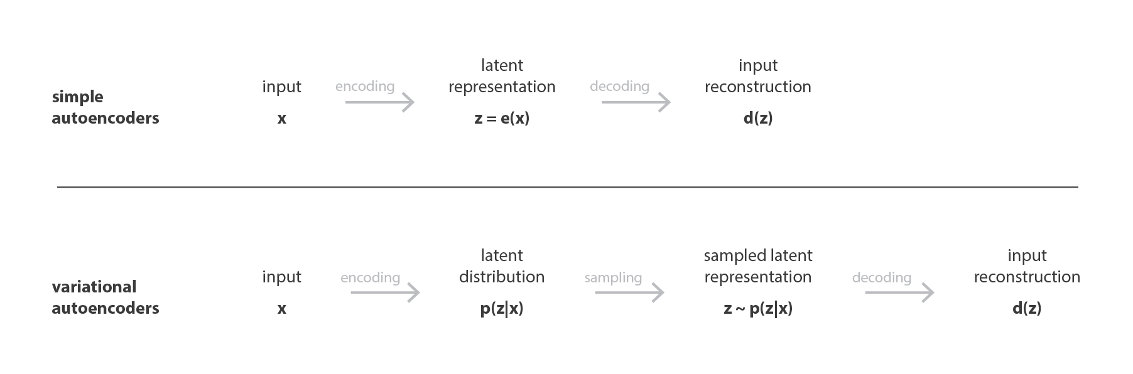
Different types of Autoencoder

Slide 10
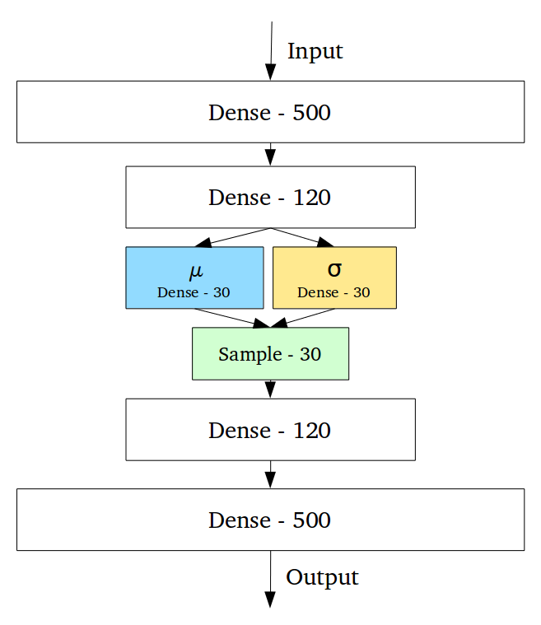
Diagram

Slide 11
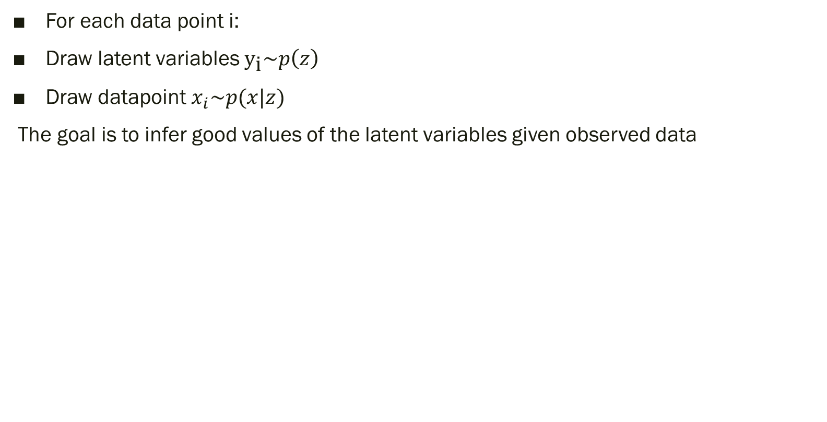
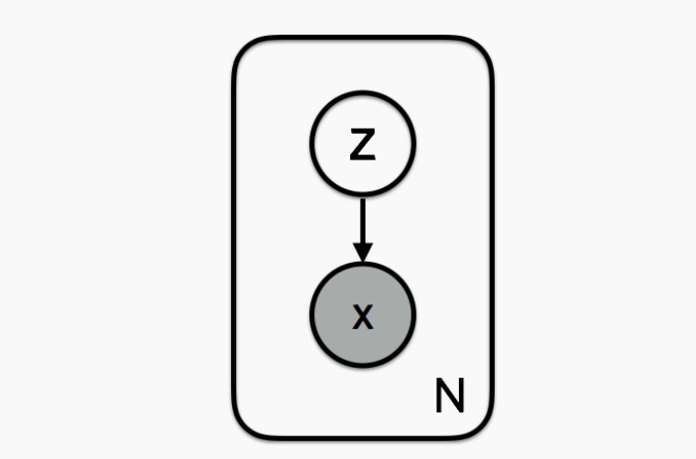

Variational Autoencoder continued

Slide 12

Assumptions in VAE
any distribution in d dimensions can be generated by taking a set of d variables that are normally distributed and mapping them through a sufficiently complicated function.
VAE assumes that samples of z can be drawn from a simple distribution. We consider this as the prior distribution, and it is a standard normal distribution ($N(0,1)$).

Slide 13
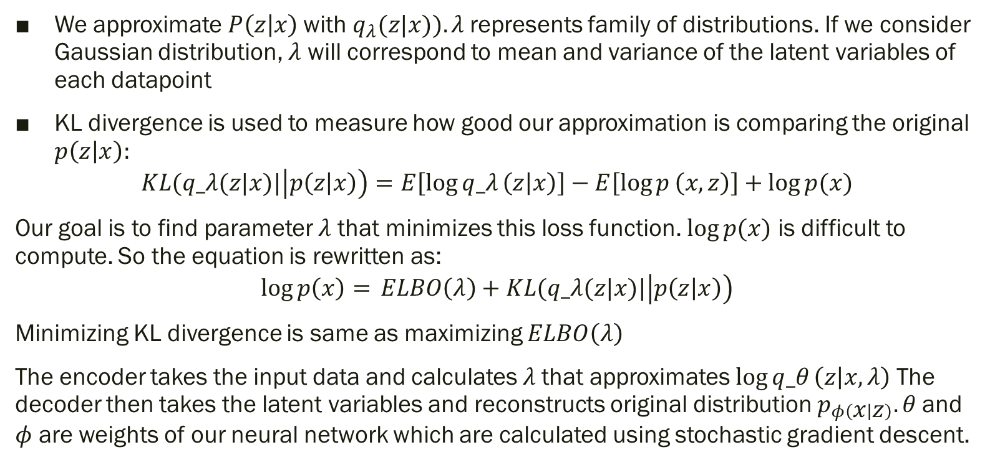
KL divergence

Slide 14
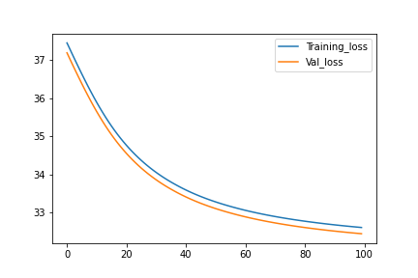
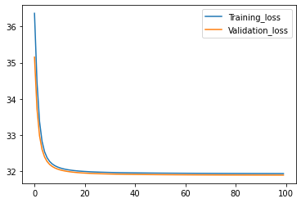
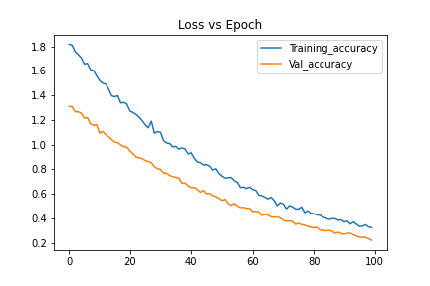
Training results from Autoencoder
Training and validation loss curve for Standard and Denoised Autoencoder
Training and validation loss curve for Variational Autoencoder

Slide 15
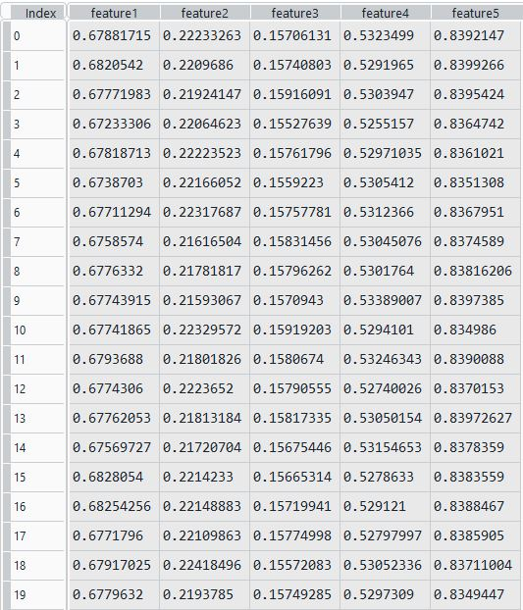
Exploratory data analysis
Reduced gene expression data from Autoencoder

Slide 16
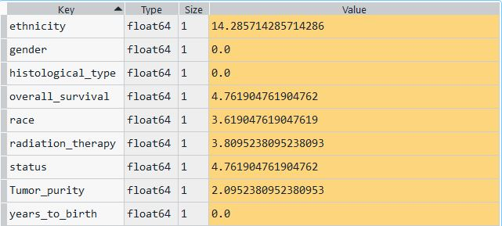
Dealing with Missing values
Percentage of missing data :

Slide 17
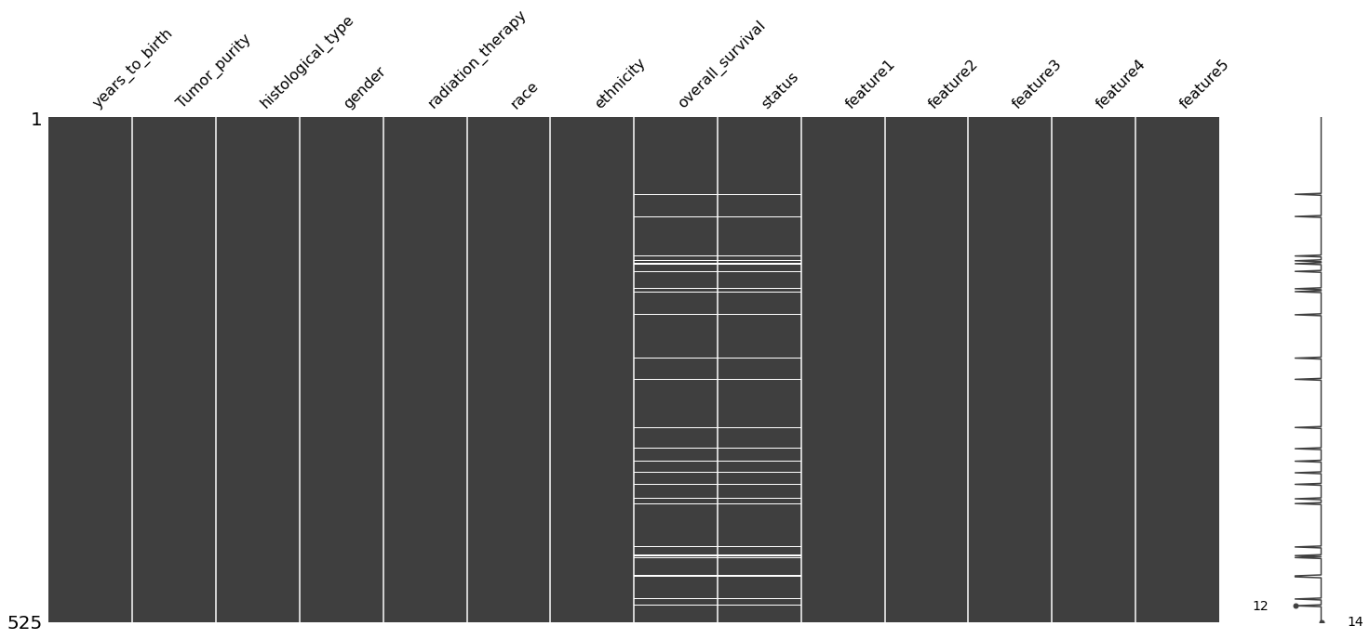
Continued

Slide 18
Feature exploration
Histological Type | Mean Overall Survival
0 | 586.20
1 | 1069.70
2 | 509.88
Gender | Mean Overall survival
0 | 557.392857
1 | 517.332237

Slide 19
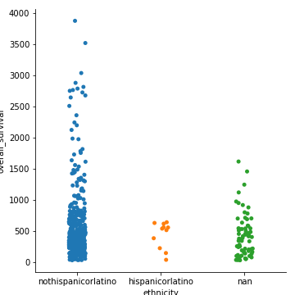
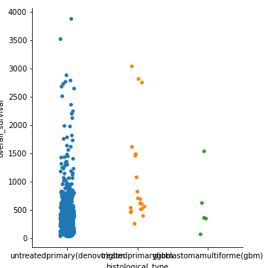
Exploring categorical features

Slide 20
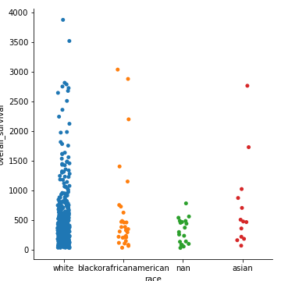
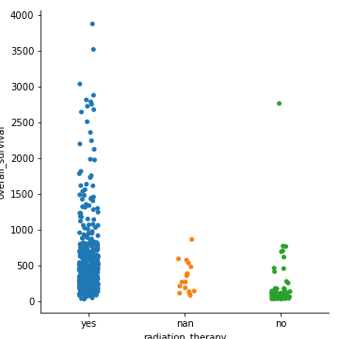
Continued

Slide 21
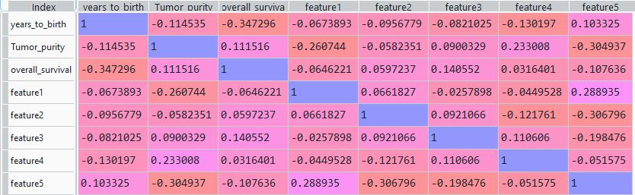
Explore Numerical Features

Slide 22
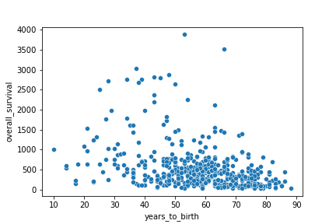
Continued

Slide 23
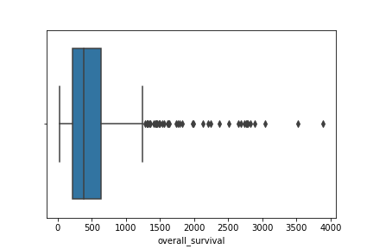
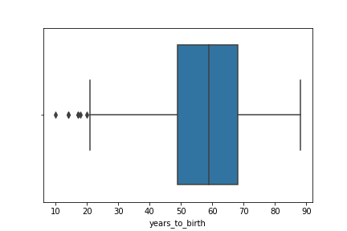
Checking outliers

Slide 24
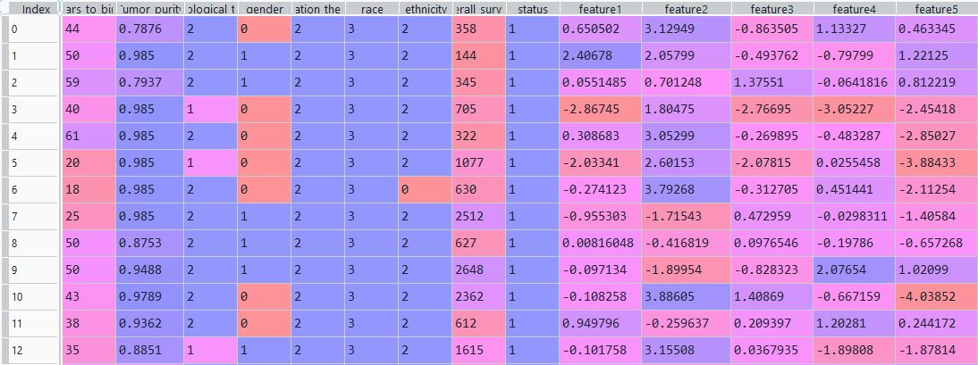
Final Models (clinical +gene features)

Slide 25
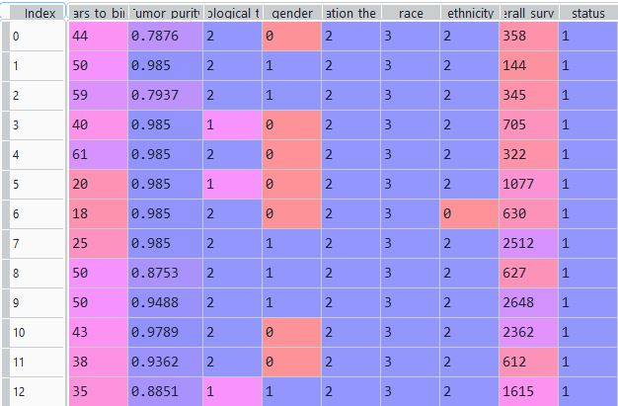
Final Model (reduced features)

Slide 26
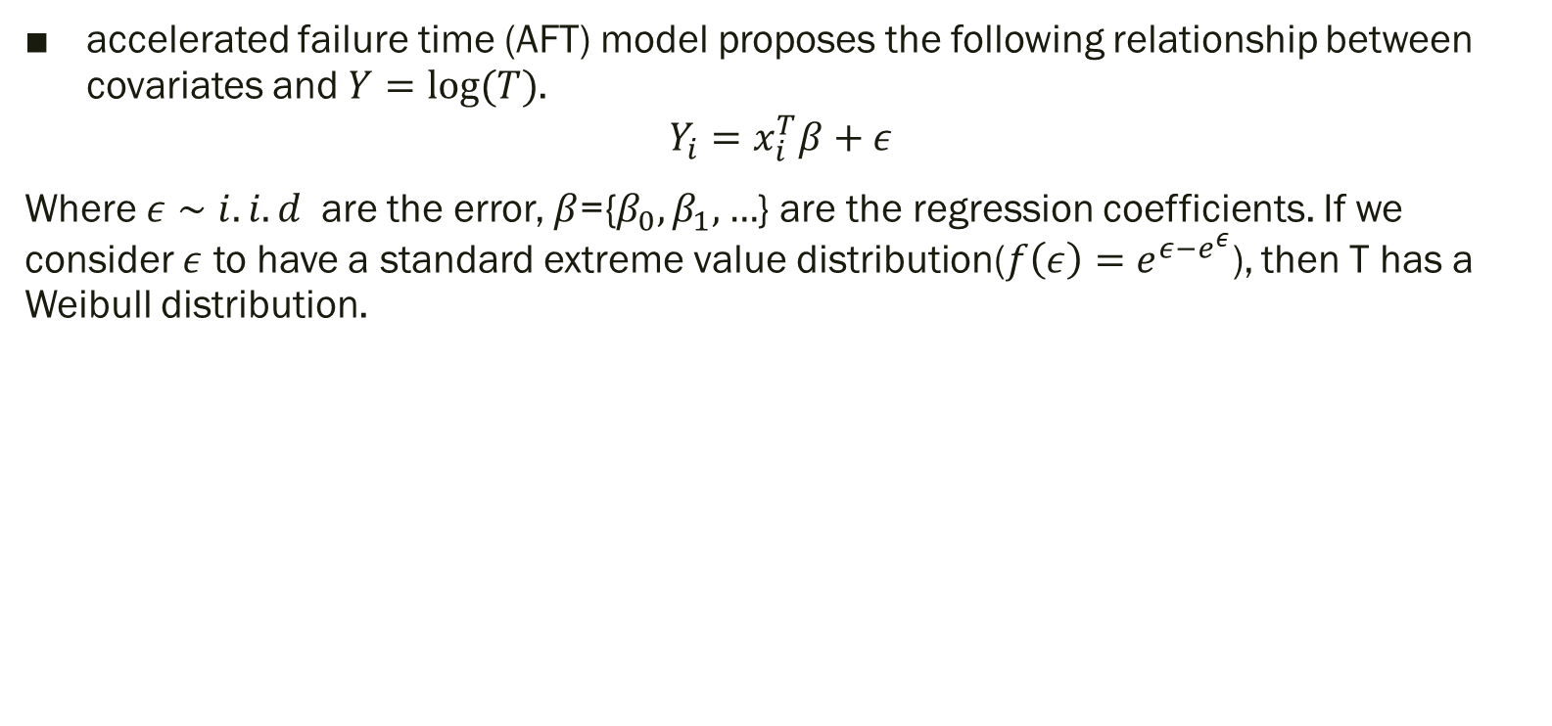
Accelerated Failure Time Model

Slide 27
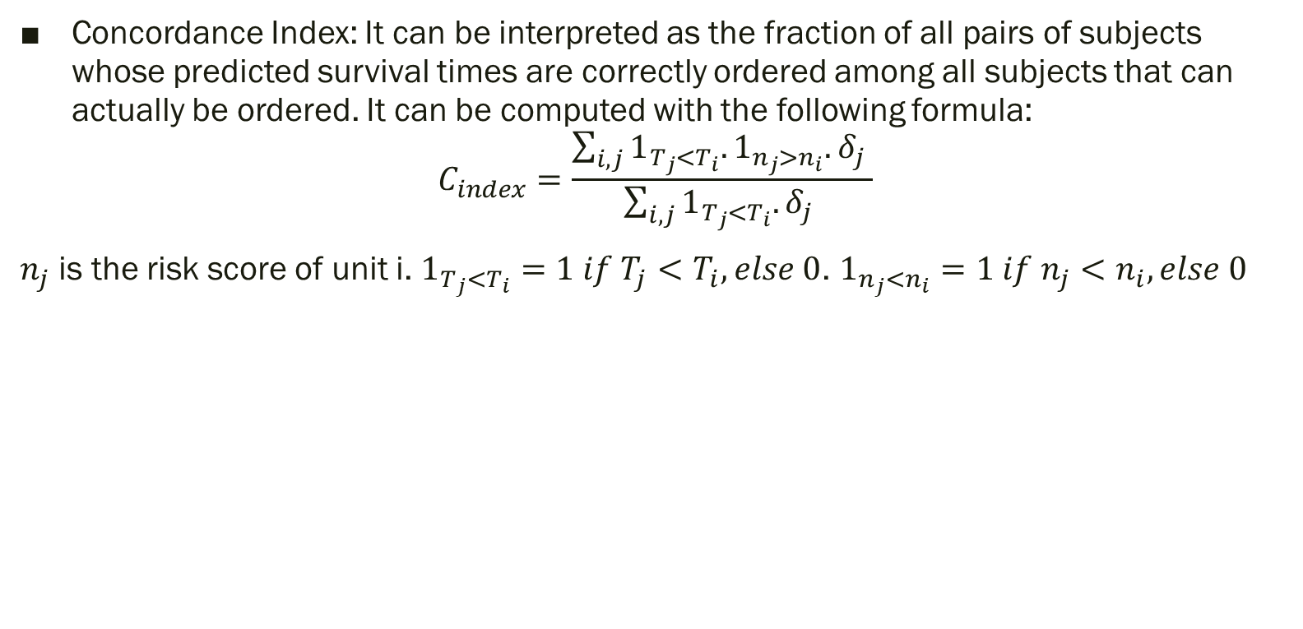
Evaluating predictions

Slide 28
Results
Autoencoder Used | Test C index of model with all features | Test C index of model with reduced features | Latency of model with all features | Latency of model with reduced features | Architecture
Standard Autoencoder | 0.67 | 0.68 | 20ms | 16ms | Hidden layer of 2000, 1000, 500 dimension Output layer size 5
Denoising Autoencoder | 0.65 | 0.64 | 21ms | 18ms | Noise amount=0.25, Hidden layer of 2000, 1000, 500 dimension Output layer size 5
Variational Autoencoder | 0.67 | 0.66 | 19ms | 17ms | Hidden layer of 100 dimension. Prior distribution of

Slide 29
Further improvements
Implement Gridsearch to find out best combinations of hidden layer size activation functions, learning rate.
Use different distributions of error functions in AFT model and analyze impact.
Use different evaluation metric.
Add more features to the final dataset (possibly using a large output from the autoencoder)

